Slide 1
CrystalMaker
Materials Science and Engineering
August 26, 2020

Slide 2
Welcome First-years!
Notes:
Adetoye
Zhang
Ekaputra
Walker
Ramesh
Purwanto Rosenmann
Chery Liu

Slide 3
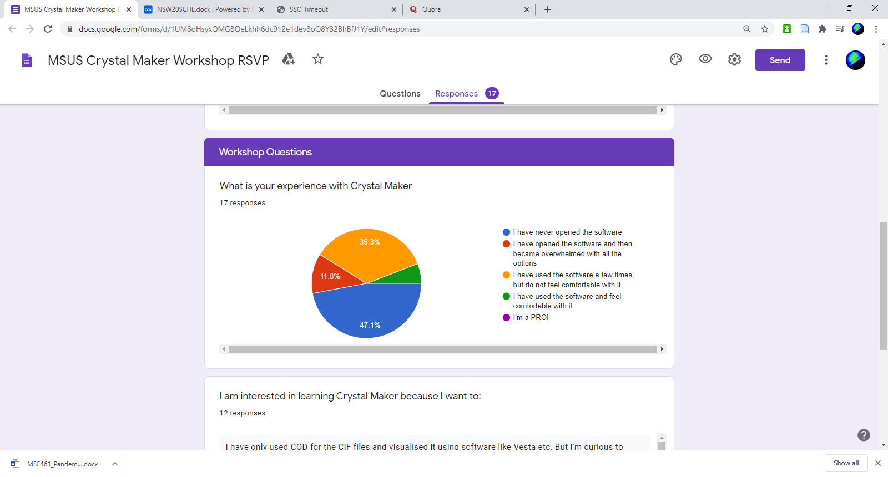
CrystalMaker - Outline
Introduction (10 min)
Building Crystals and Basic Navigation (20 min)
Diffraction (15)
Powder simulations
Single crystal simulations
Consulting/Requests
Box Link: https://northwestern.app.box.com/s/s63nlkvdtnax6s22okstcj251ajjk8ay

Slide 4
Requests
Better visualization of crystal structures (×6)
Learn more about crystallography (×2)
Make nice figures (×2)
General research tool competency (×2)

Slide 5
CrystalMaker Workshop - Outcomes
Attendees will be able to access CrystalMaker as well as other useful, free software from Northwestern.
Attendees will be able to
Create crystals from scratch
Use a crystallographic datafile to render crystal structures
Attendees will have the ability to investigate structure and symmetry details of any crystal structure they may encounter in classes or research.
Attendees will be able to create publication-quality images.
Attendees will be able to simulate IR, diffraction, and

Slide 6
(Some) Free Competitors
VESTA - https://jp-minerals.org/vesta/en/
Mercury - https://www.ccdc.cam.ac.uk/Community/csd-community/freemercury/
PyXtal* - https://pyxtal.readthedocs.io/en/latest/
J(S)mol - http://jmol.sourceforge.net/
Many more…
Notes:
VESTA – compatibility with DFT data. Electronic structure visualization. Broad import option formats.
Mercury – powerful for visualization and computes simple powder structures.
J(S)mol – Java/JavaScript creation of applets and HTML5 snippets that can be embedded into webpages.
PyXtal – Clean, powerful, opensource Python interface.

Slide 7
CrystalMaker Strengths:
Intuitive GUI
Versatile visualization, rendering, and annotation options
Diffraction calculations
Multistructure/Interface visualization
[Native Mac Program]
Extremely satisfying sound effects

Slide 8
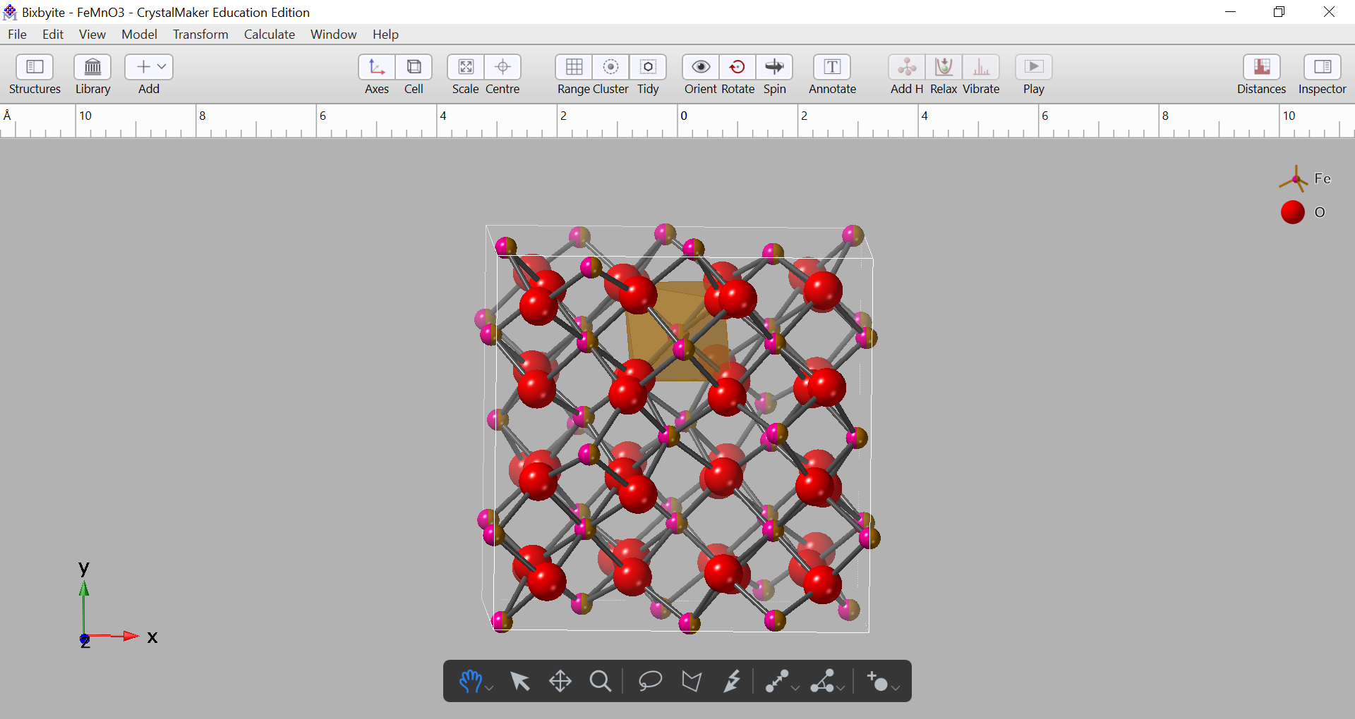
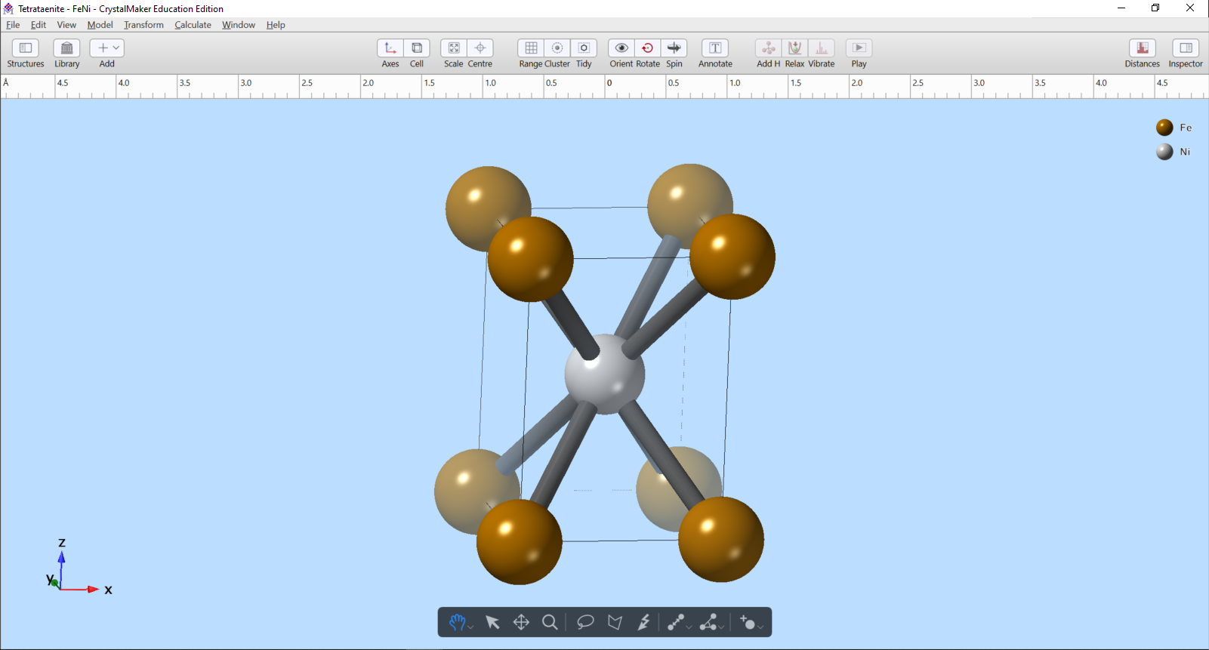
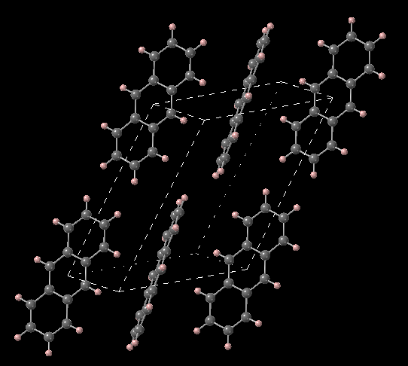
CrystalMaker Gallery
Notes:
FeNi
Bixbiyite FeMnO3
Antracene – wide band gap organic semiconductor

Slide 9
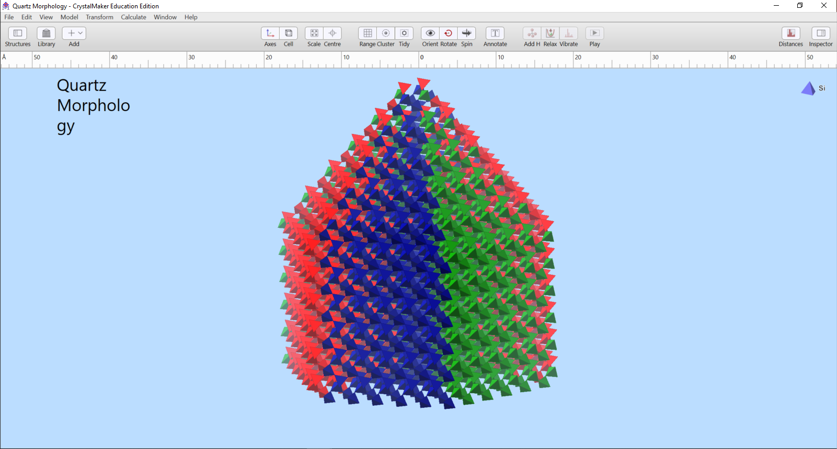
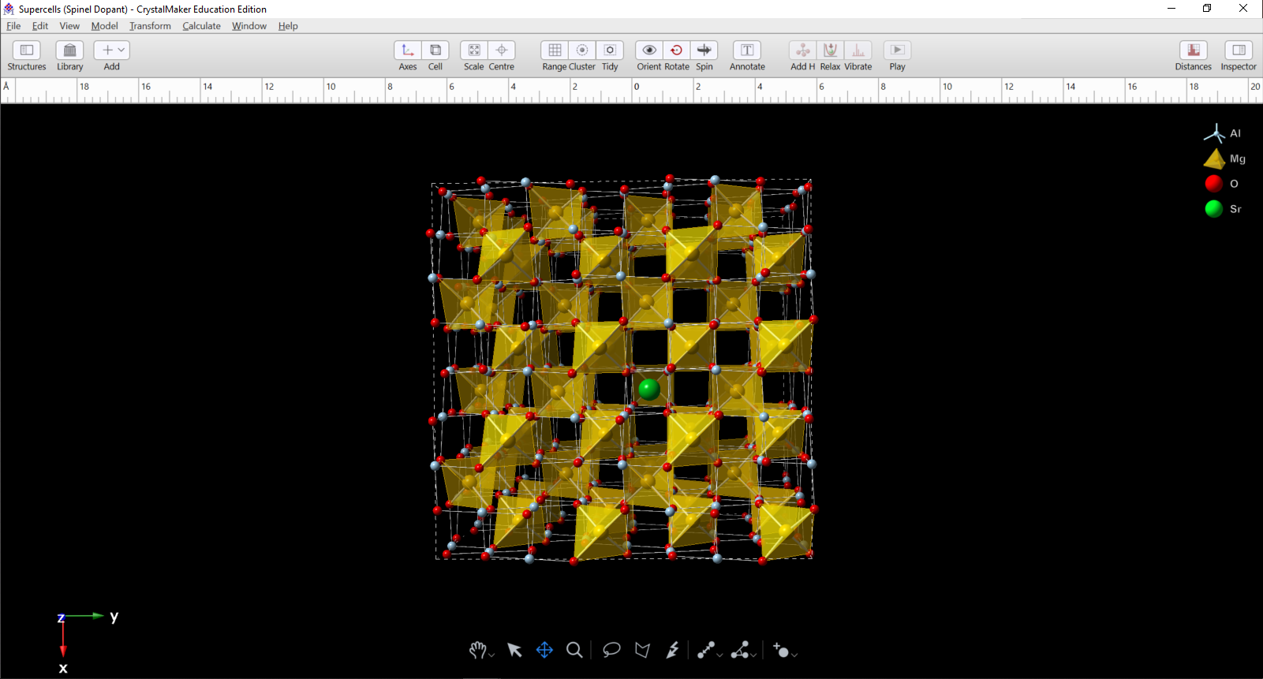
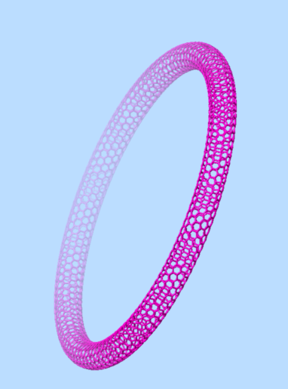
CrystalMaker Gallery
Notes:
Sr-doped spinel (MgAl₂O₄)
Quartz habit
Bucky torus

Slide 10
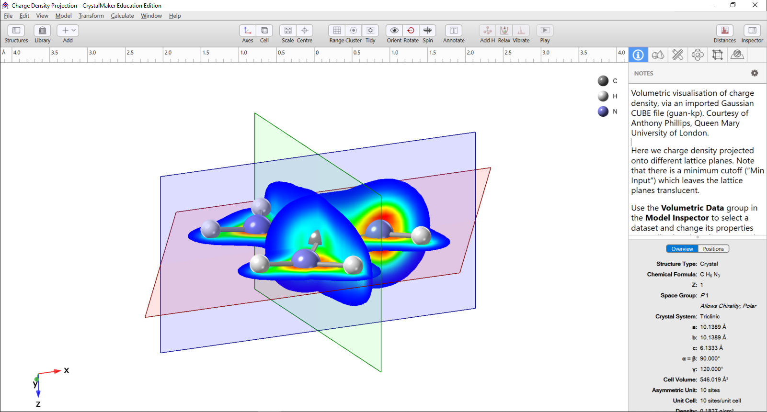
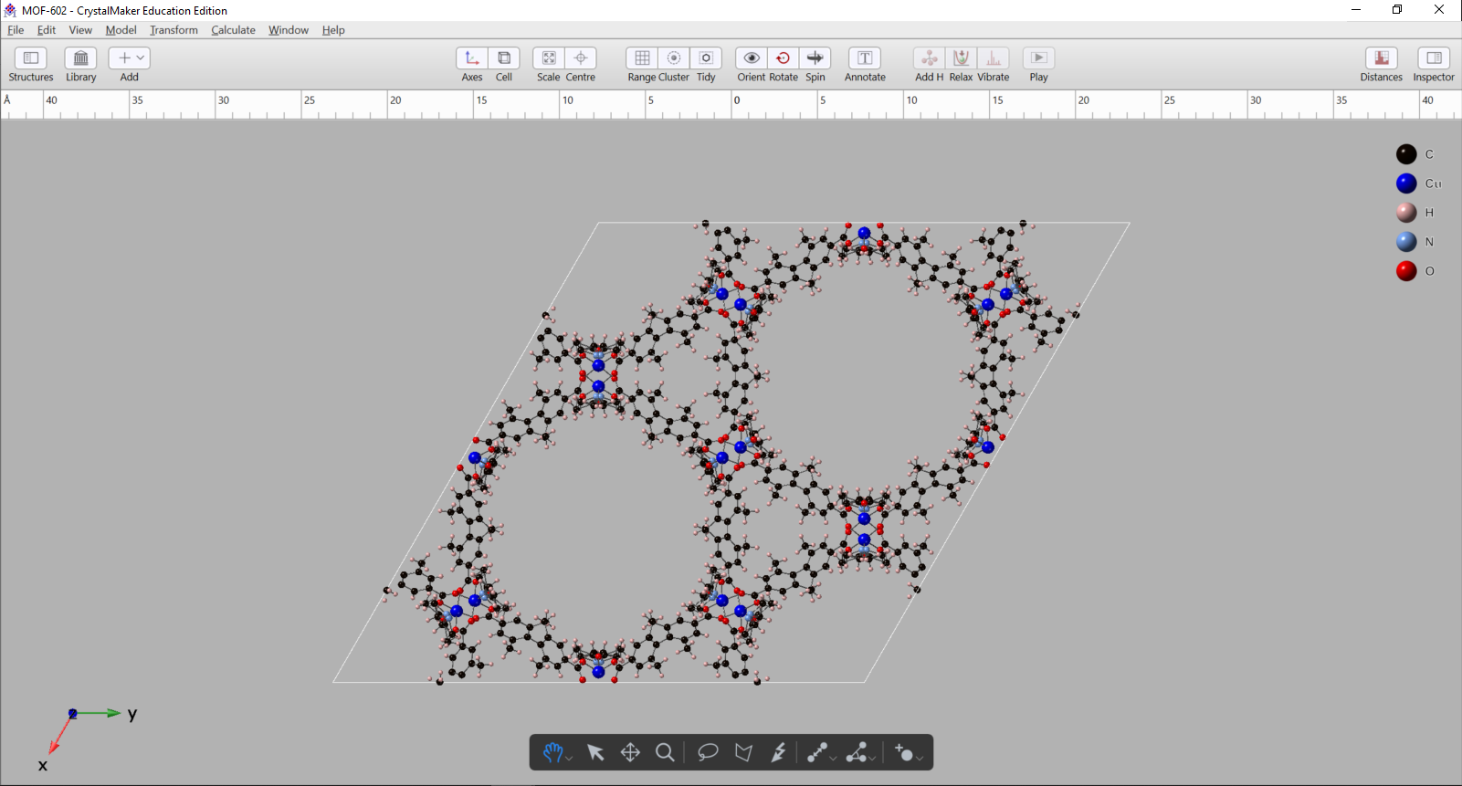
CrystalMaker Gallery
Notes:
Charge density projections of guanidinium cation

Slide 11
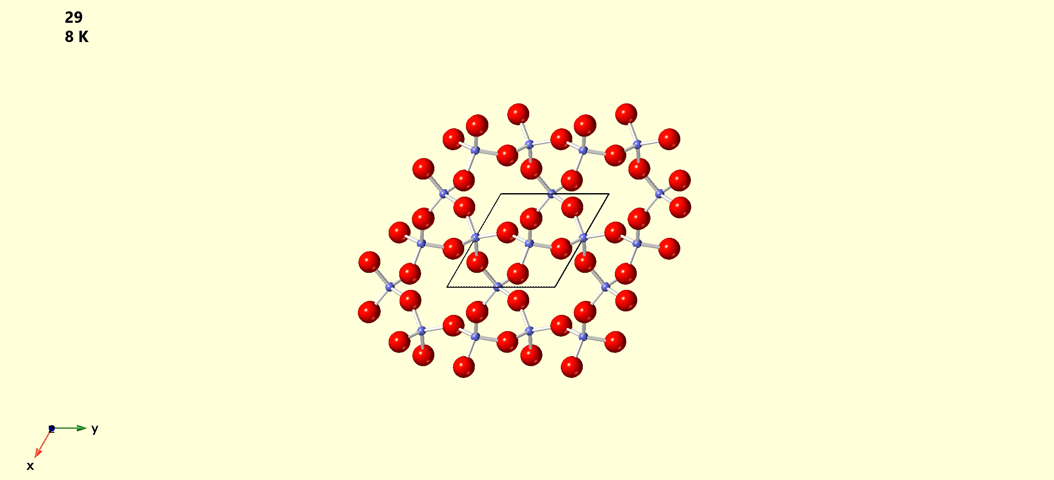
CrystalMaker Gallery
Notes:
Charge density projections of guanidinium cation

Slide 12
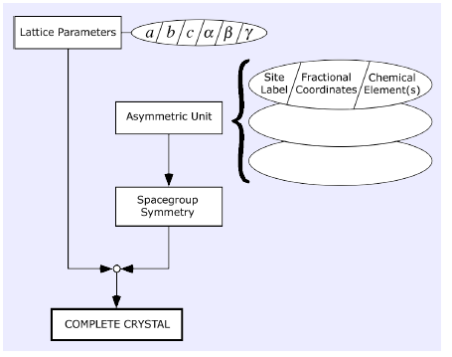
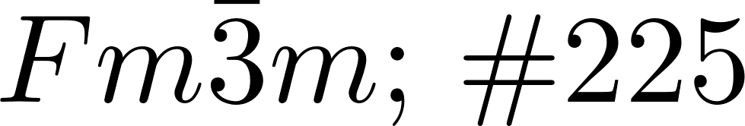
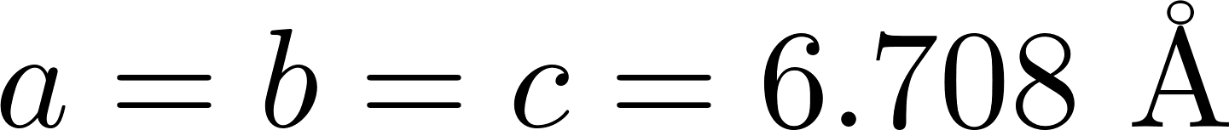
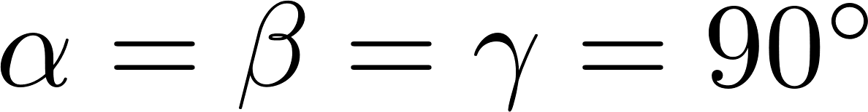
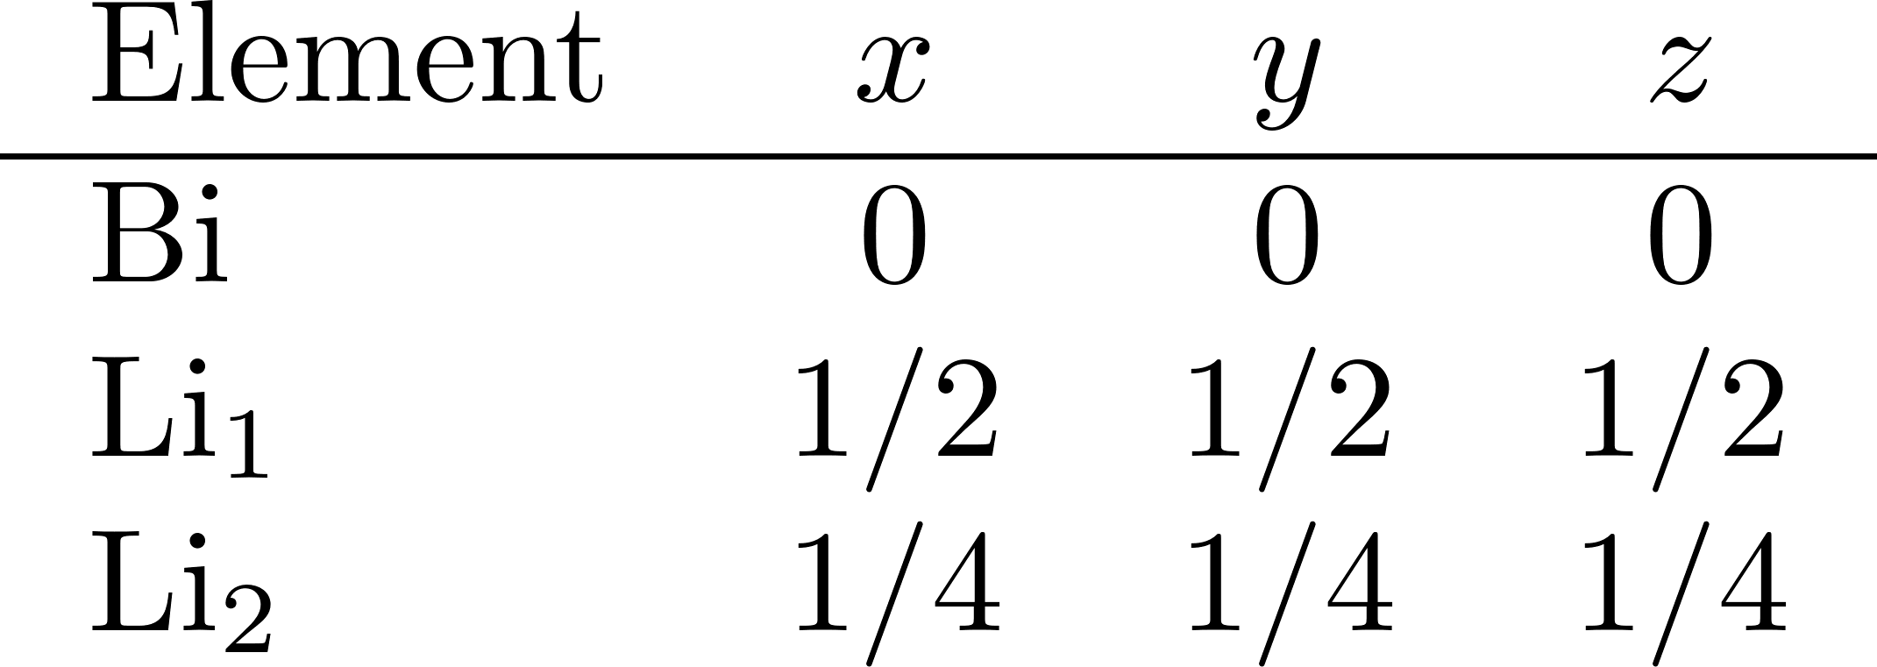
Getting Started
Open CrystalMaker
We’re going to work with Li₃Bi

Slide 13
Interactivity
Think in orthogonal screen axes.
Crystallographic axes will rotate with crystal.

Slide 14
Interactivity
Click and drag to rotate crystal
Shift/“Rotate” click and drag to rotate about screen z-axis
Pinch or mouse wheel to zoom in and out

